Slide 1

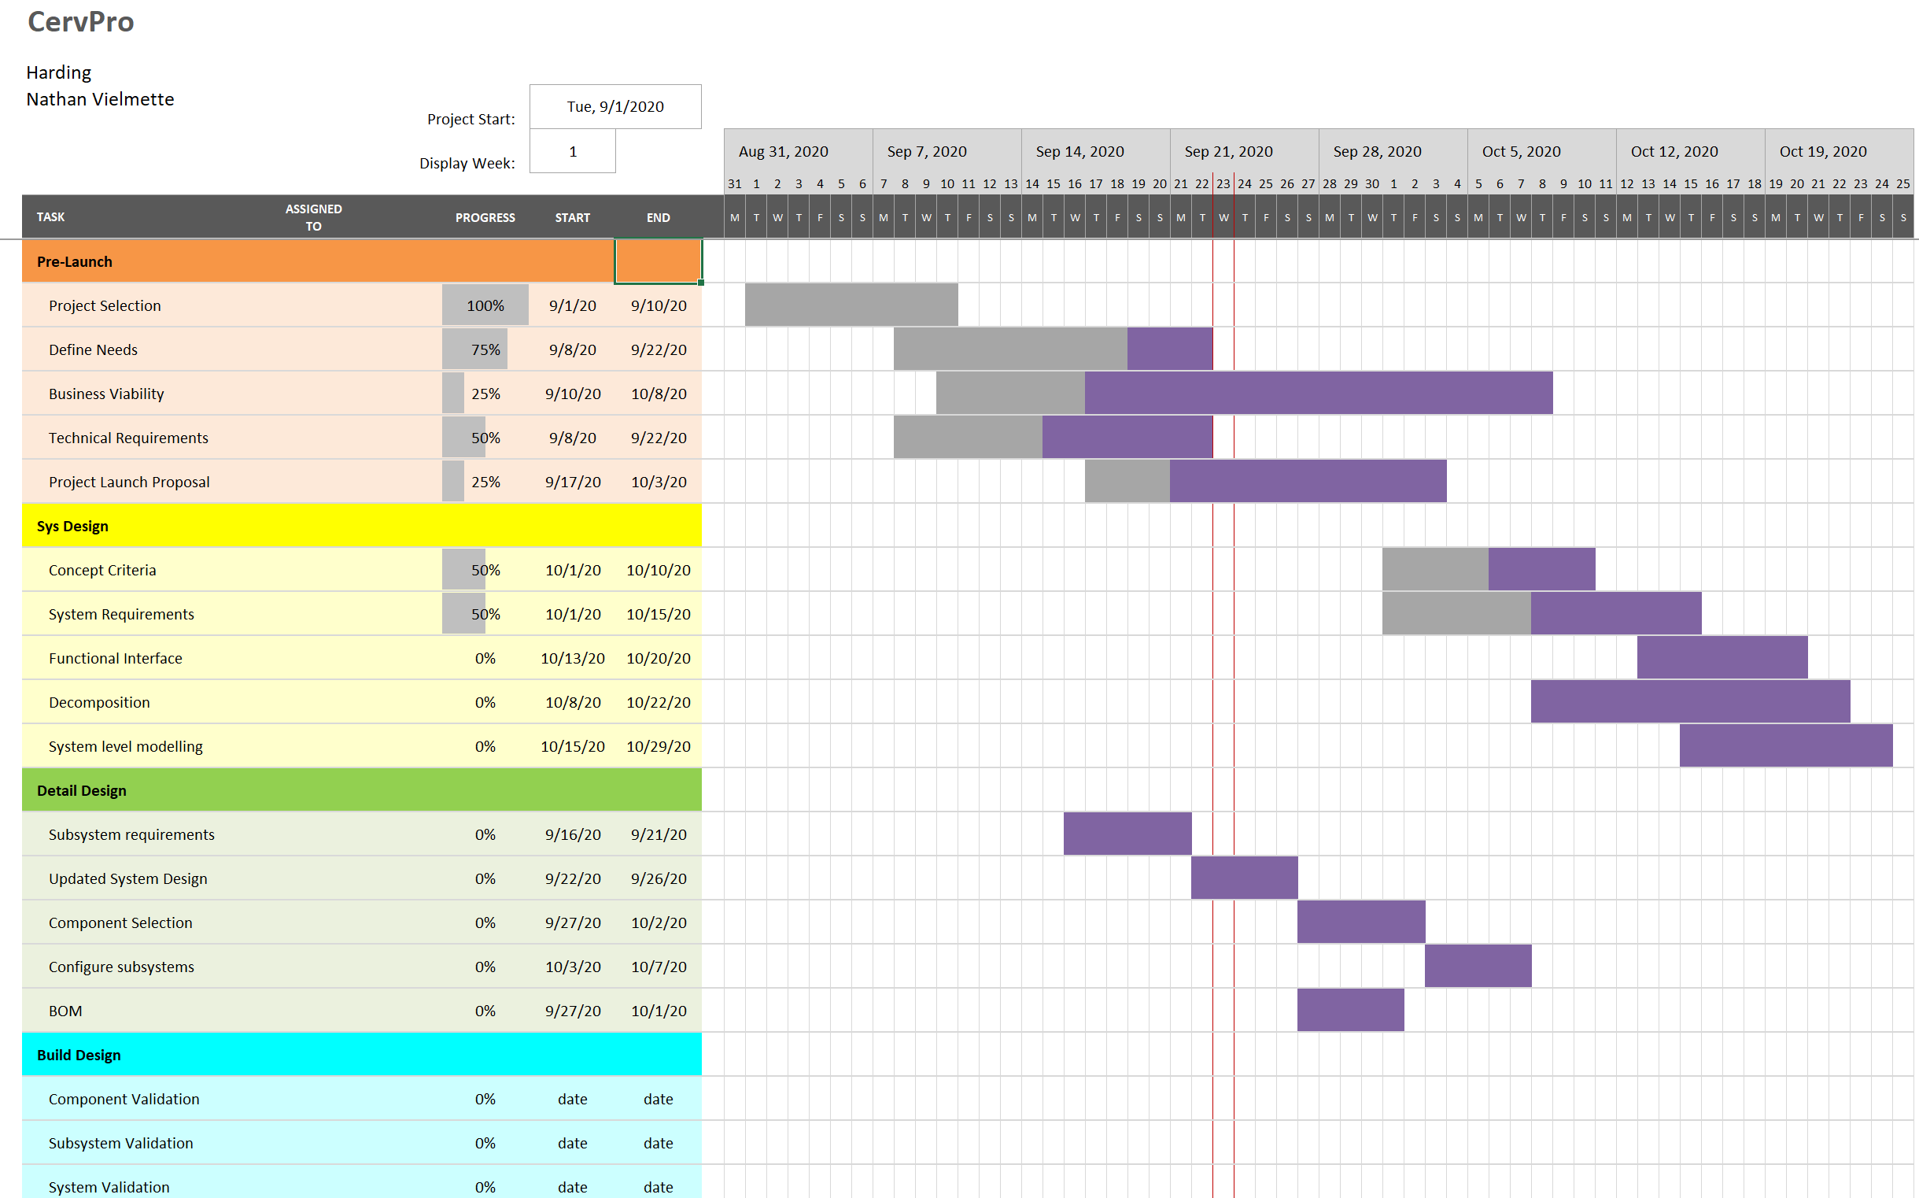

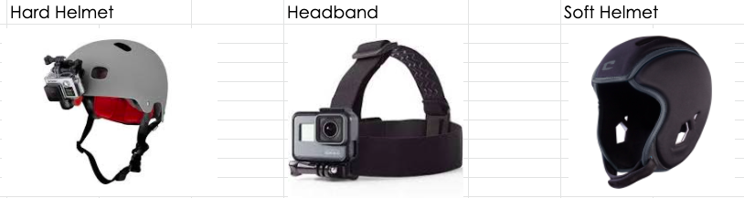
CervPro
Cervical Proprioception Diagnosis: A3 Status
Date: September 24, 2020
Members: Nathan Vielmette, Ethan Grimes, Keneth Chelelgo, and George Cook
Background
PT cervical proprioception (CP) assessments are subjective and are largely determined by PT experience/opinion.
Motivation is to create device that gives PTs objective data that shows patients’ ability to sense head and neck position in space.
Device will be headgear that senses head position and angular velocity.
Proposed Countermeasures
Implement decision-making matrices to eliminate subsystem ideas.
Initiate communication with business student partner
Quantify PT information into a numerical standard for testing
Investigate which standards are required and how to achieve compliance
Recent Results
Completed Decision Making Matrix for various headgear types (Fig. 2)
Selected Arkansas Governor’s Cup sponsor and partner
Defined preliminary specifications
Current Conditions
Goals/Targets
Device will be user friendly
Patient will feel comfortable with device on head
Accurately measures head and position and speed
Device will be mobile and lightweight
Analysis
Subsystem designs not chosen
We don’t have a sufficient understanding of the market viability
PTs don’t use quantitative terminology so testing standard seems imprecise
Health regulations for sensors and comm systems are unknown
Next Steps
Have a type of sensor communication technology picked out. (George)
Limit sensor type possibilities to between 2 and 4 sensors. (Nathan)
Decide on a couple hard helmets to use to mount device. (Ethan and Keneth)
Meet with business student to discuss product business viability (Nathan)

Slide 3
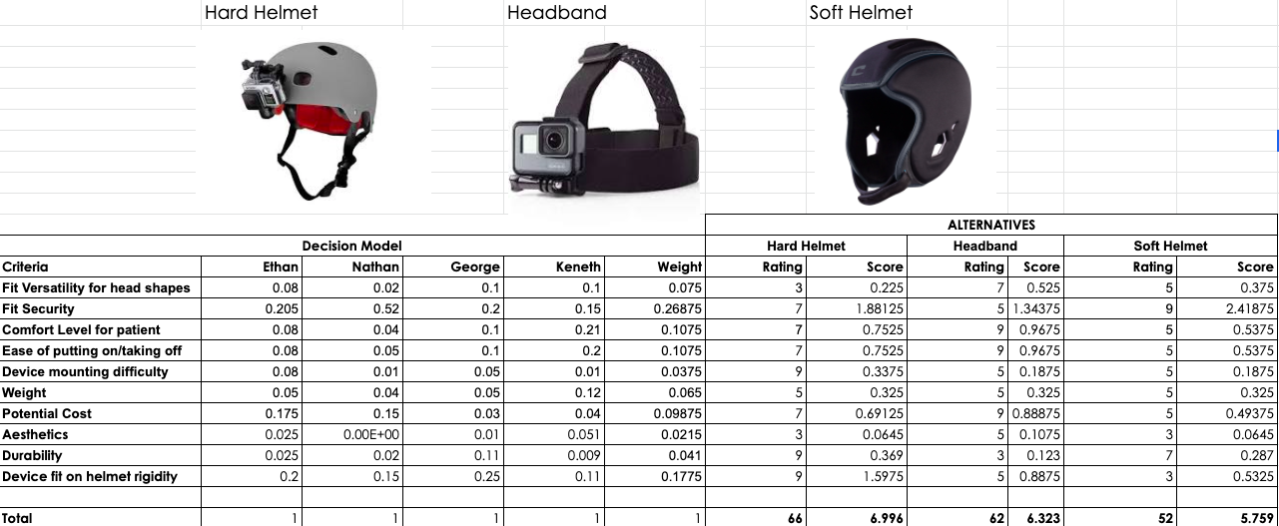

Slide 4
Product Specifications
Ease of Use:
Mean time for new user to run CPE test shall not exceed double standard CPE time
Proportion of users able to receive data from CPE test in less time than standard shall exceed 50%
The average of the inverse of the number of questions asked by a new user shall not exceed ⅓
Proportion of users able to make diagnosis exclusively and within 30s of completing device cycle shall exceed 50%
Functionality:
Helmet position shall shift less than 5° when the head covers RoM 10x at 1Hz
Output error at distances of .5m, 1m, 2m, and 3m shall not exceed 5%
Output error at 1m and TBD frequencies for CPE, VOR x1 and 2 shall not exceed 5%
Output repeatability error at 1m and CPE frequency with 10 samples shall not exceed 5%
Data shall be saved to file while indicating therapist-defined output

Slide 5
Product Specifications
General:
EHS: no laser shall be greater than class 2
Regulatory Law: Shall meet all legal requirements for a device of its type
Mobility: largely articulated by weight specification, but must not significantly impede movements across range of motion (RoM)
Size: subsumed under mobility
Sound: shall not emit distracting levels of noise
Wireless Transmissions: Wireless transmissions will be in the ISM range
Patient: Able to comfortably wear the headgear while also wearing glasses
Undecided:
Weight: “As light as possible”
Price: TBD based on PT, Marketing, and Manufacturing data

